Slide 1
SEMINAR ON “DATA ANALYSIS”
GUIDED BY
DR. VINOD SIR
PRESENTED BY
MR.SUMAN KUMAR MISS. ANUJA SALVI
MR. ROHIT CHANDRA MISS. ASHWINI TICHKULE
MR. ROHIT SANJAI MR. ASHISH TIWARI

Slide 2
Introduction
The Dataset contains food items of different manufacturer with country of origin and also their nutrient content where calorie is the focus attribute .
This data gives us the measurement of calories, protein, fat, sodium, fiber, carbo, sugars, potass and vitamins per serving.
Also, we have a ratings of each food product.
We are analysing the provided dataset to find the calorie reach food along with other nutrients and their correlation.
Provided dataset also provides information about the most common source of food and also the ratings for each of them.

Slide 3
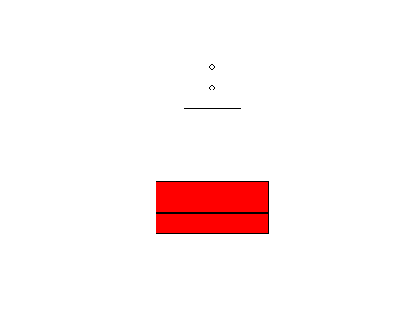
Dataset analysis and enrichment
This data set have 16 columns and 78 rows in which 3 columns are categorical and others are numerical.
In this dataset, Carbo, sugar and Potass have missing values which have been populated using kNN function.
There are some outliers are present in dataset which has been replaced with upper and lower threshold value.
Boxplot for sodium

Slide 4
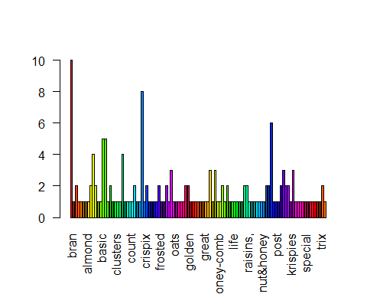
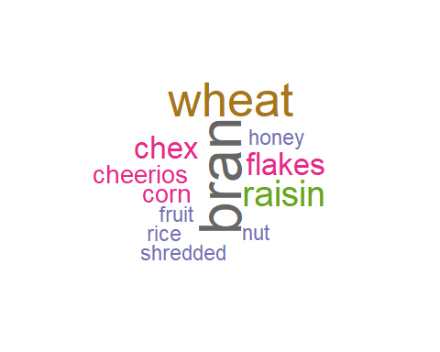
Measure source
Using wordcloud we could identify the food source which is repeated most of the time and there frequency
Bran, wheat, Raisin, chex and flekes are the most common food items, Bran is the source of 10 food items.
Bar plot for frequency of food item
Word cloud

Slide 5
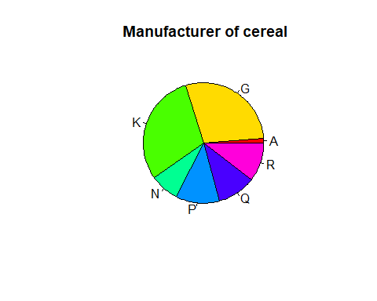
Manufacturer’s analysis
As per dataset k-kelloggs, G-General Mills, P- Post, R- Ralston purina supply 30% , 29%, 12%, 10% respectively.
A | = | American Home Food Products
G | = | General Mills
K | = | Kelloggs
N | = | Nabisco
P | = | Post
Q | = | Quaker Oats
R | = | Ralston Purina
29%
30%
10%
8%
10%
12%

Slide 6
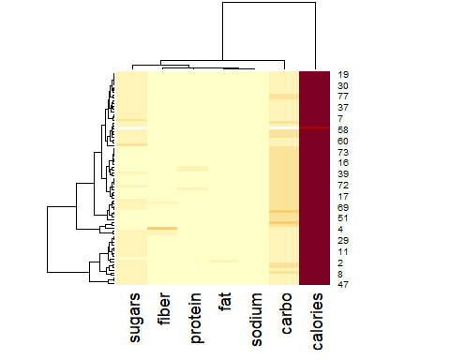
Nutrient Content Heat map
Heat map represents the concentration of different magnitude for all the columns showing in map.
Brighter the color showing lesser magnitude and darkest color is showing the higher magnitude.
As we can see in the heatmap all nutrients broadly divided in two category i) colorie and ii) all other nutrients And the second subgroup divided into all other subgroups.

Slide 7
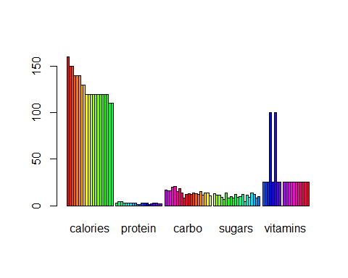
Group Bar Plot for top 20 food items based on calorie.
A grouped bar plot display a numeric value for a set of entities split in groups.
Maximum Calories per serving =160(Mueslix Crispy Blend)
Grouped Bar plot

Slide 8
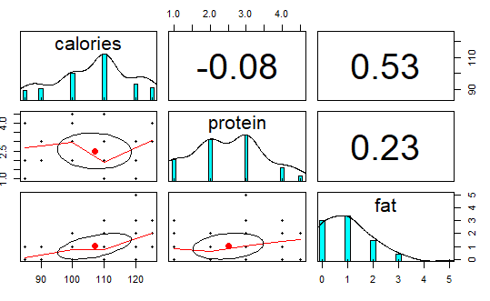
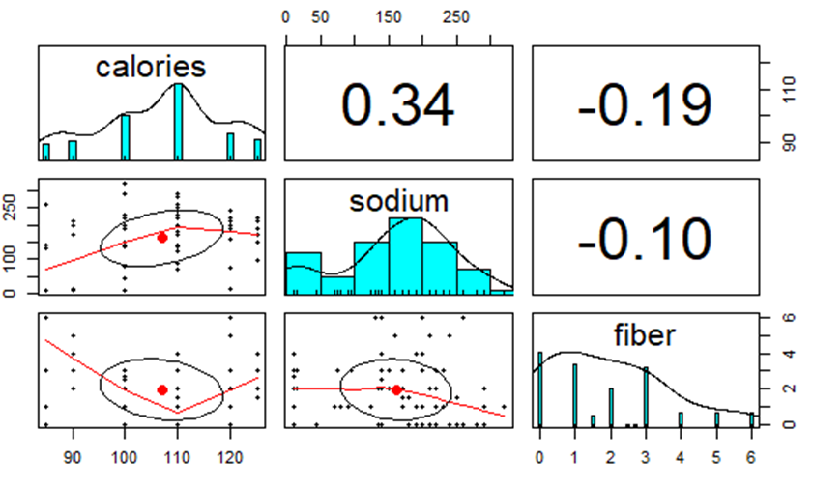
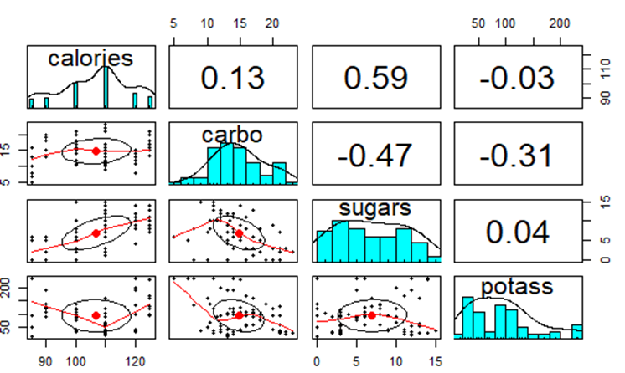
Correlation of Calories with all other nutrients
Conclusion:
Positive correlation with Calories.
Sugar>Fat>Sodium>Shelf> Carbo >Cups
0.59>0.53>0.34>0.15>0.13>0.08
If we increase calories rating will be lower and if we increase Sugar or Fat the calories will be higher.

Slide 9
Summary
Average, Minimum and Maximum level of nutrients from the provided the dataset
calories
Min. : 50.0
Avg :106.9
Max. :160.0
protein
Min. :1.000
Avg :2.545
Max. :6.000
fat
Min. :0.000
Avg :1.013
Max. :5.000
vitamins
Min. : 0.00
Avg : 28.25
Max. :100.00
potass
Min. : 15.00
Avg : 98.67
Max. :330.00
fiber
Min. : 0
Avg : 2.152
Max. : 14
sugars
Min. : 0.000
Avg: 7.026
Max. : 15.000
carbo
Min. : 5.0
Avg : 14.8
Max. : 23.0

Slide 10
Thank You…
Project Website: EDA Cereals Proj
https://imarticsproject.wixsite.com/edacerealsproj

